Slide 1
Fairness In Machine Learning With Unstructured Data
Student: Karim Kallich, Shippensburg University, ak2206@ship.edu
Mentor: Pranav Narayanan Venkit, Penn State Univ, pranav.venkit@psu.edu
Researcher: Ahmed Rashed, Shippensburg University, amrashed@ship.edu
Date: 06/14/2024

Slide 2
Fairness In Machine Learning With Unstructured Data
Main Idea: This project is an extension for my work on identifying and mitigating bias in machine learning models. In the first project we applied various ML bias techniques to structured data. In this project, we have extended the techniques to unstructured data. The problems we have tackled are computer vision and natural language processing (NLP).
Libraries used:
Fairlearn by Microsoft
AI Fairness 360 (AIF360) by IBM
What-If-Tool by Google

Slide 3
Metrics Used in Identifying Bias
Fairlearn and What-If-Tools Library:
Demographic Parity Difference: The maximum absolute difference between groups for the demographic parity which is a fairness metric whose goal is to ensure a machine learning model’s predictions are independent of membership in a sensitive group.
Equalized Odd: The goal of the equalized odds fairness metric is to ensure a machine learning model performs equally well for different groups. It is a measure for the quality-of-service harms can occur when a system does not work as well for one person as it does for another.
AIF360 Library:
Statistical Parity Difference: Difference in selection rates which is the percentage of samples with positive selection
Average Odds Difference: Returns the average of the difference in false positive rate (FPR) which is a measure of accuracy for a test and true positive rate (TPR) which is a performance metric used to evaluate the effectiveness of binary classification models in machine learning.
Equal Opportunity Difference: Returns the difference in recall scores (TPR) between the unprivileged and privileged groups in the sensitive feature.
Generalized Entropy Index: Generalized entropy index measures inequality (non-randomness) over a population. Index=0 means non-randomness =0 or in other words randomness is maximum and thus the model fairness is maximum. The bigger the index the worse the fairness.
Theil index: It measures the same thing as generalized entropy index. The generalized entropy index is especially sensitive to the existence of large data, whereas Theil index is especially sensitive to the existence of small data.

Slide 4
Comparison of Libraries
Fairlearn:
Advantages:
Easy to use. Useful for educational purposes.
Disadvantages:
Limited metrics and mitigation algorithms.
Very slow with big datasets.
Supports only binary classification tasks.
AIF360:
Advantages:
Large number of metrics and mitigation algorithms.
Can handle all classification tasks.
Disadvantages:
Some algorithms needs high computational resources (e.g. Learning Fair Representation).
What-If-Tool:
Advantages:
Interactive tool with visualizations for model’s predictions.
Disadvantages:
Limited in terms of mitigation algorithms.
Outdated library.

Slide 5
Goals
Bias Identification: Determine if the models are biased towards a specific group (e.g. gender/ethnicity).
Bias Mitigation: Use algorithms from fairness libraries to mitigate the models’ biases.
Perform the bias analysis to unstructured data (computer vision and natural language processing (NLP))
Use the three fairness libraries in the analysis.

Slide 6
Fairness In Machine Learning With Unstructured Data
Timeframe
Start date: 3/25/2024
End date: 6/10/2024

Slide 7
What we accomplished (Results)
Computer Vision Model:
Based on face image, gender and ethnicity, predict the age group.
Sensitive features: Gender and Ethnicity.
Dataset Website: https://www.kaggle.com/datasets/jangedoo/utkface-new

Slide 8
Fairlearn Library

Slide 9
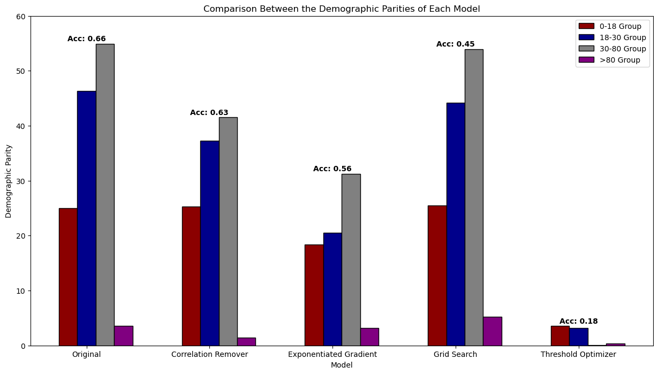

Slide 10
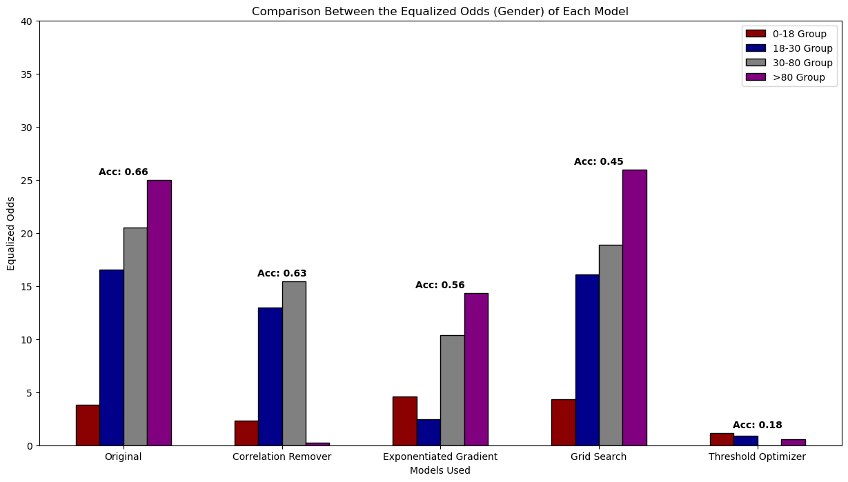

Slide 11
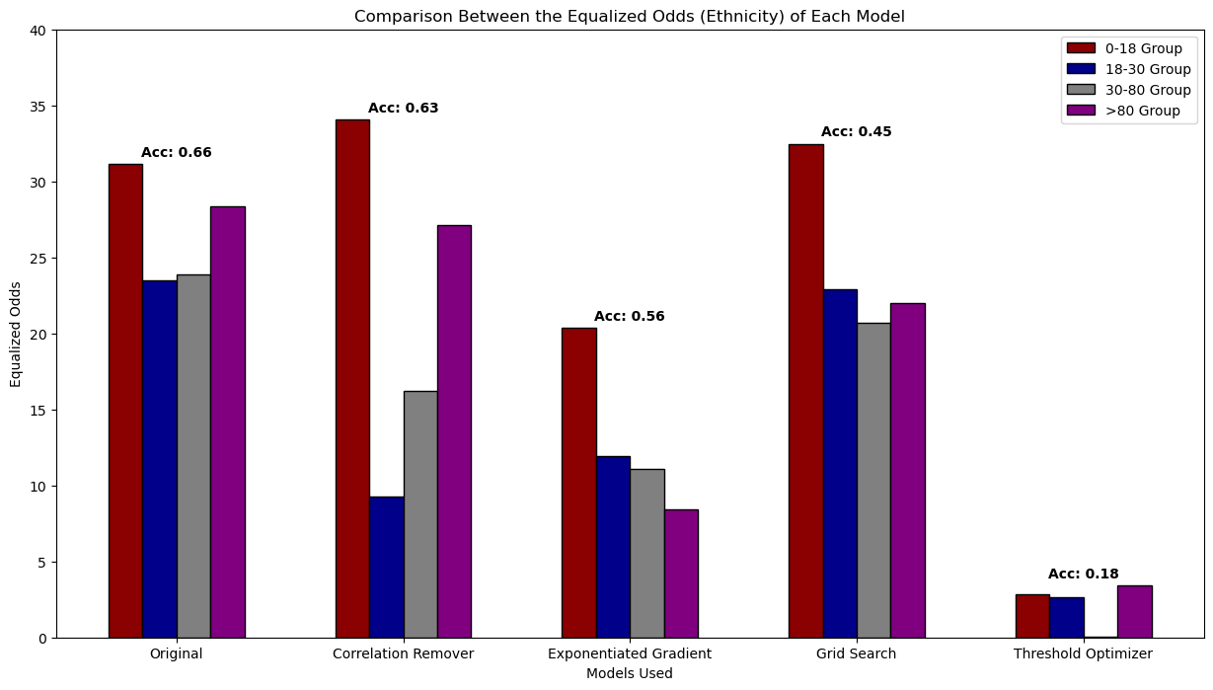

Slide 12
Insights
Reducing bias usually reduces the accuracy of the model.
Correlation Remover and Exponentiated Gradient are the best mitigating algorithms that reduce bias while maintaining a relatively high accuracy.
Threshold Optimizer reduces bias to almost zero but reduces accuracy significantly as well.
Grid Search doesn’t work on images. It increases bias while reducing accuracy.

Slide 13
AIF360 Library

Slide 14
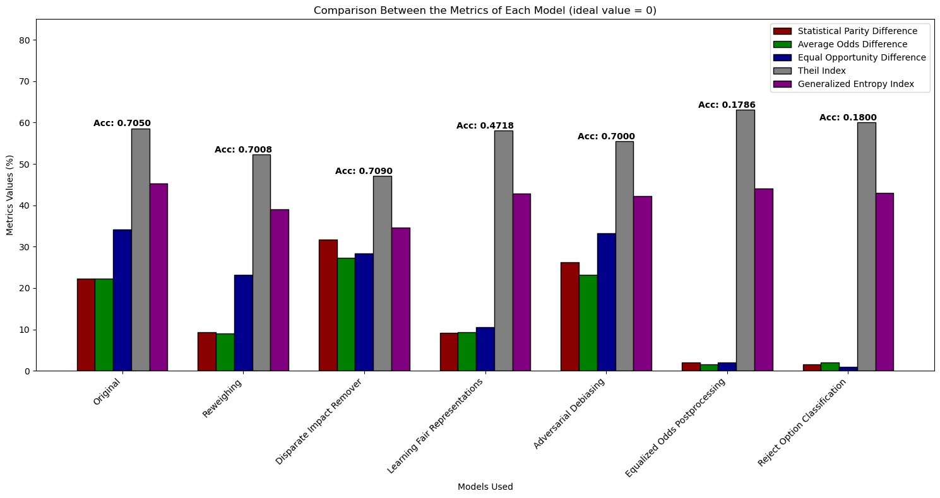

Slide 15
Insights
Reweighing, Disparate Impact Remover and Adversarial Debiasing show the best results by reducing bias and maintaining almost same accuracy.
Postprocessing algorithms (Equalized Odds Postprocessing, Reject Option Classification) are useless as they reduce accuracy significantly.
AIF360 shows diversity in metrics that measures different types of biases in data, making the identification comprehensive.
Technical Notes:
There are some other mitigation algorithms in AIF360 that either are not related to our work or didn’t work with our model. For example, “Exponentiated Gradient Reduction” didn’t work with Tensorflow framework that we use.
“Learning Fair Representation” needs a lot of time to finish.

Slide 16
What-If-Tools Library

Slide 17
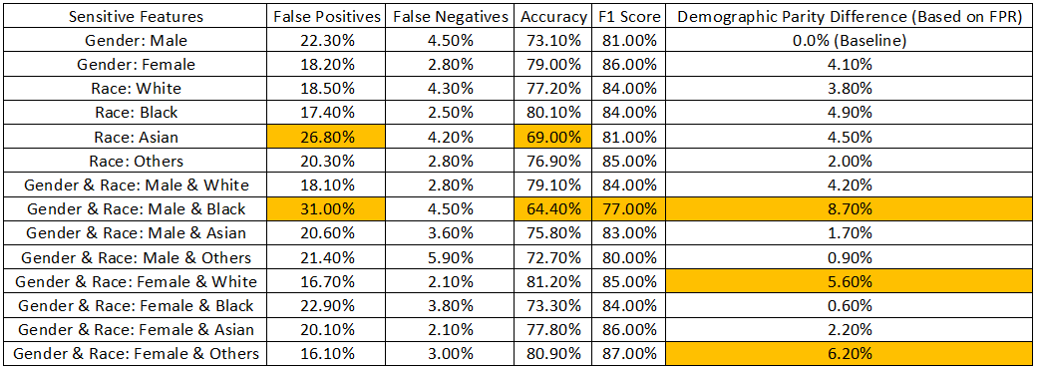
Insights:
Can identify bias effectively through “Demographic Parity Difference”.
No good mitigation algorithms.

Slide 18
What we accomplished (Cont.)
Natural Language Processing:
Based on doctors’ findings, patient gender and age group, determine if the patient needs urgent intervention or not.
Sensitive features: Gender and Age group.
Dataset Website: https://www.kaggle.com/datasets/prasad22/ca-independent-medical-review

Slide 19
Fairlearn Library

Slide 20
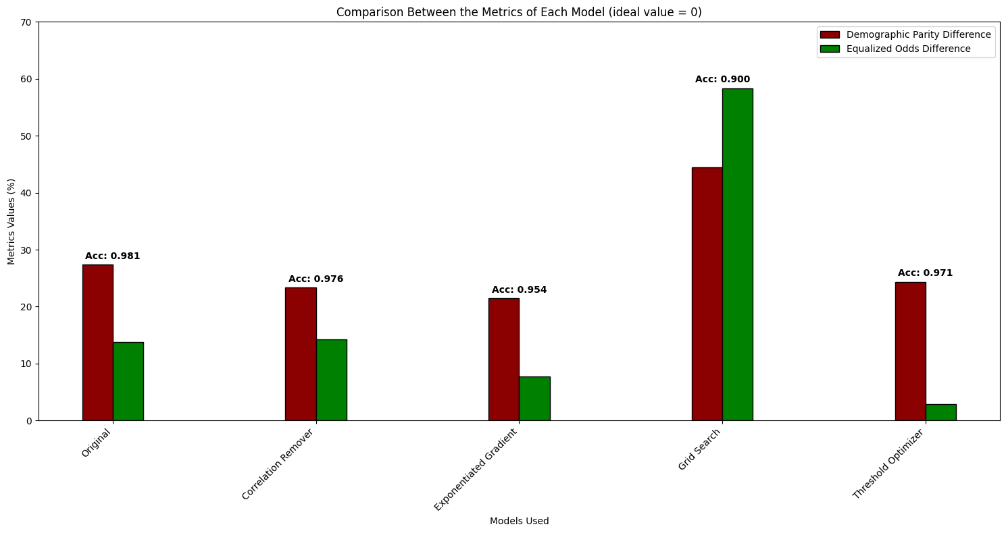

Slide 21
Insights
Threshold Optimizer showed the best performance here by preserving accuracy and reducing bias.
Correlation Remover and Exponentiated Gradient reduced the bias only marginally.
Grid Search doesn’t work here as well. It increases bias while reducing accuracy.

Slide 22
AIF360 Library

Slide 23
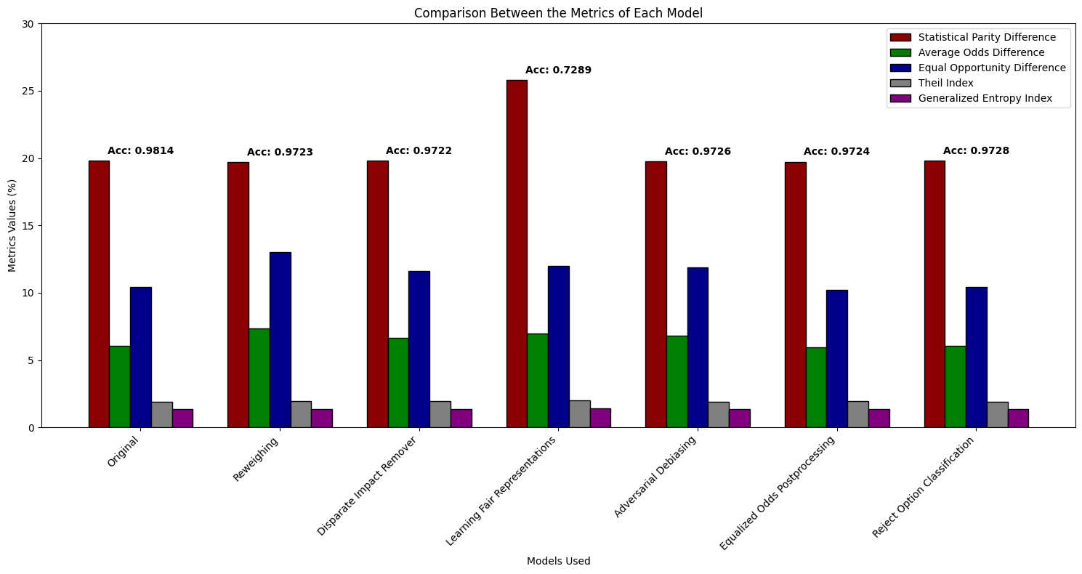

Slide 24
Insights
There are no big differences before and after applying the mitigation algorithms with this data and model.
This might indicate that this model is already maxed out in terms of fairness, and for further improvements another model should be used.

Slide 25
Lessons Learned
I have learned a lot of machine learning fairness techniques
The results from fairlearn and AIF360 were good
What-If-Tool is not a main tool for ML fairness, so it is not suitable for this purpose.
I could have used a high-performance computational facilities to perform the bias analysis for the computer vision model. But, I preferred not to go that far as this is an educational research project. But, it should be used in a real-life project to get more accurate results.

Slide 26
Publications/Contributions
My team is planning to publish this work in the proceeding of the “The 39th Annual AAAI Conference on Artificial Intelligence” in February 25 – March 4, 2025 | Philadelphia, Pennsylvania, USA

Slide 27
Contributions to Research Computing Community
(Please include links and topics!)
Knowledge Base Contributions
Ask.CI contributions
https://ask.CI
CI Links contributions
https://careers-ct.cyberinfrastructure.org/knowledge-base/ci-links
Github contributions
https://github.com/necyberteam
Github of the project
https://github.com/mohammad2012191/Fairness-in-Machine-Learning-Identifying-and-Mitigation-of-Bias/

Slide 28
Acknowledgements
I would like to appreciate my P.I. (Ahmed Rashed) and mentor (Pranav Venkit) for the discussion and guidance. I also would like to thank the volunteer student (Mohamed Eltayeb) for collaborating with me. Finally, I would like to thank the committee of the CAREERS project for supporting this research.

